Slide 1
Creating Statewide Longitudinal Data Systems (SLDS)
That Provide Useful Information
A Four-Part Webinar Series
October 2025 -February 2026

Slide 2
Webinar 1: So, You Want a State Dashboard?
Taking a User-Centered Approach to Making Data More Available
October 2025

Slide 3
Agenda
  Introduction of our framework
  Key considerations for dashboards
  Lessons from Michigan, Minnesota, & Nebraska
  Panel discussion
  Q&A

Slide 4
Who we are
Actionable Intelligence for Social Policy (AISP)
Data Quality Campaign (DQC)
Education Commission for the States (ECS)
WestEd’s Data Integration Support Center (DISC)
Access our SLDS whitepaper
https://bit.ly/3-functions
Notes:
Add link to whitepaper bitly
Add org links to chat

Slide 5
What is an SLDS?
1
2
3
4
  Systems connect data
  Data are linked at the individual level
  Data are longitudinal
  Data security and privacy are core requirements

Slide 6
Read more about the functions at https://bit.ly/3-functions

Slide 7
Why the Functions Framework Matters
& How It Helps States
  Shows how the SLDS serves people and informs decisions, rather than being a technology project
  Encourages states to let purpose drive design, not structure
  Supports states in aligning technical, legal, and governance frameworks with the services people need
  Clarifies how data systems can be designed to provide actionable information for learners, policymakers, and communities

Slide 8
Webinar Series: Creating an SLDS That Provides Useful Information
Helping state leaders maximize the potential of their SLDS
Focus on user-centered design rather than tech-only solutions
Support states in building actionable and transparent data systems
Share practical, plain-language strategies states can apply immediately

Slide 9




Webinar Series
Webinar 1
So, You Want a State Dashboard?
Webinar 2
Empowering Individuals with Data
Webinar 3
Maximizing the Power of Research & Analytics
Webinar 4
Bridging Education to Workforce

Slide 10
Features of the
Public Reports & Dashboards Function
  PROS
  Effective at showing time trends and comparisons
  Allows for information that is commonly used to be shown consistently across locations (institutions, regions, statewide)
  Allows for information to be replicated consistently over time
  CONS
  Information is generally provided once or twice a year by state agencies, which must first be cleaned, so it is not real-time and often lags more than a year
  Information is shown for groups of people, so small groups may not be displayed (generally 10 people)
  Limited opportunity to change how the information is processed and visualized

Slide 11
Key Considerations for the
Public Reports & Dashboards Function
Audiences
  Education leaders, state agencies, policymakers, public advocates
Goals
  Transparency, accountability, efficiency
Opportunity
  Dashboards can visualize opportunity gaps that can shape policy (e.g., whether veterans have the same graduation rates)
Interface
  Plain language, intuitive visuals, multi-level data literacy support
Usability
  Engage with the public to explain the content and support interpretation
Sustainability
  Stable structures are needed to ensure dashboards are designed to meet the needs of multiple users, regularly updated, and adjusted based on dashboard use

Slide 12
Common Challenges for the
Public Reports & Dashboards Function
Infrastructure
  Dashboards are built without support to maintain and refresh the information
  Ensuring that identities are kept private (tension with desire for detailed exported data)
  Resource scarcity to sustain dashboards and respond to new requests
Interface
  Format is not aligned with the intended user (level of technicality)
  Format does not present information in the format that aligns with the use case (multiple clicks or exports needed to secure needed information)
Lack of Engagement
  Dashboards are released without a plan to ensure users can access or make use of the data
  Data system administrators don't know how to reach the audience effectively

Slide 13
Panelists
Nick Armit
Michigan MI School Data Portal
Nora Morris
Minnesota Office of Higher Education
Matt Hastings
Nebraska Statewide Workforce & Educational Reporting System

Slide 14
Our Questions for Panelist
An Informed Conversation

Slide 15
Q&A
Please Submit questions
using the Questions and answers (Q&A) tab at the bottom of your zoom

Slide 16
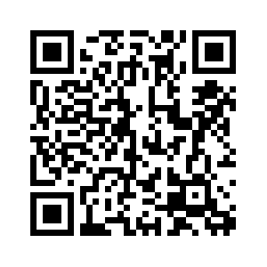
Next Steps
WestEd will send you an email with links to other webinars in the series
You can view and share this webinar (https://disc.wested.org/resources/)
Join us for Webinar 2: Supporting Individuals Function
November 21, 10:00-11:00 (PST)
Notes:
https://docs.google.com/forms/d/13g80JQD71qSR_p3j7ieyLUaLZ8zHKU9ImO0Z6Xnn6Fo/preview
Kathy 1min

Slide 17
Thank you!
Stay in touch with by emailing us at DISC@wested.org
or by visiting us at DISC.WestEd.org

Slide 18
APPENDIX: STATE SLIDES

Slide 19
STATE SLIDES: Michigan

Slide 20
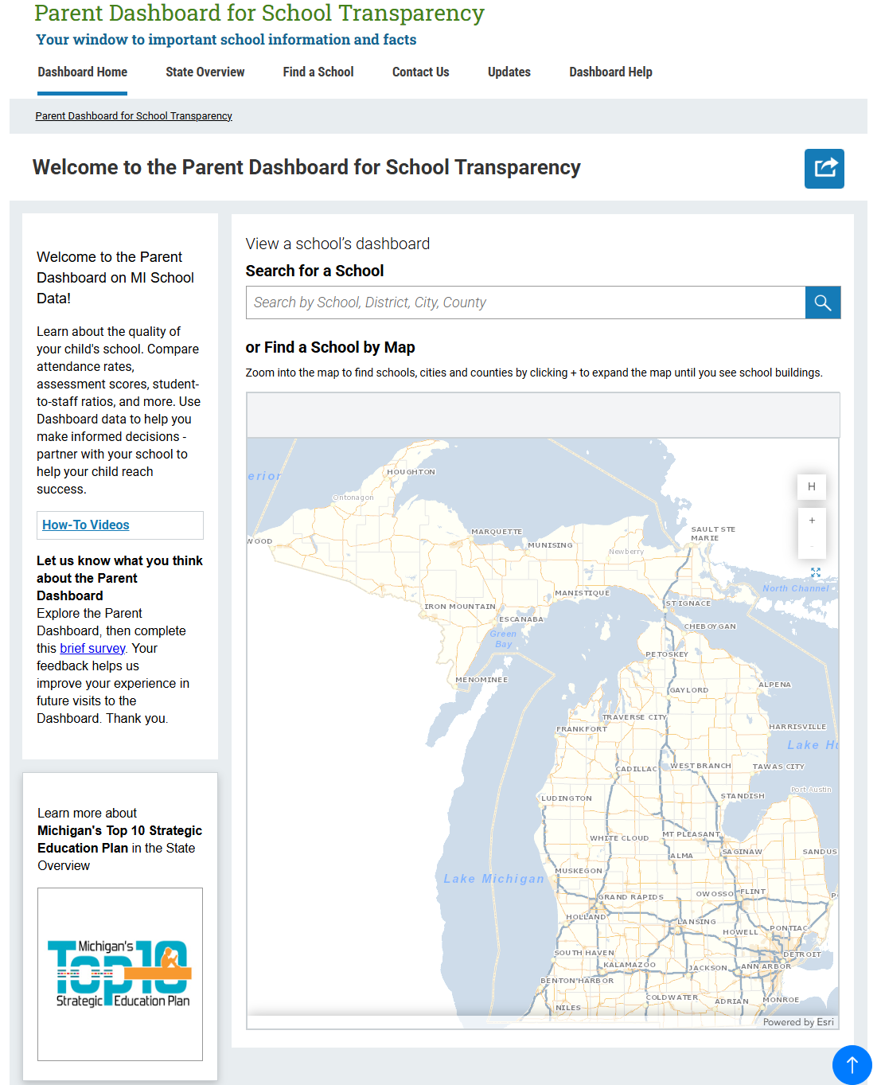

Slide 21
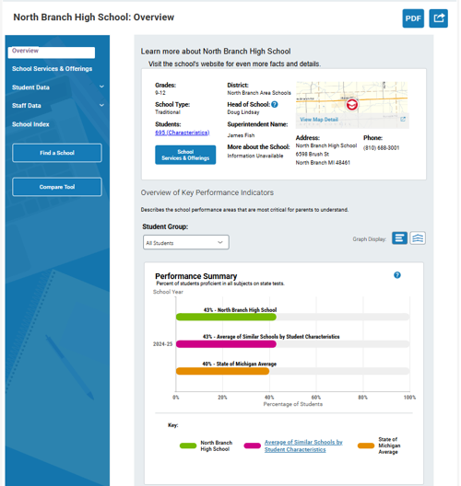

Slide 22
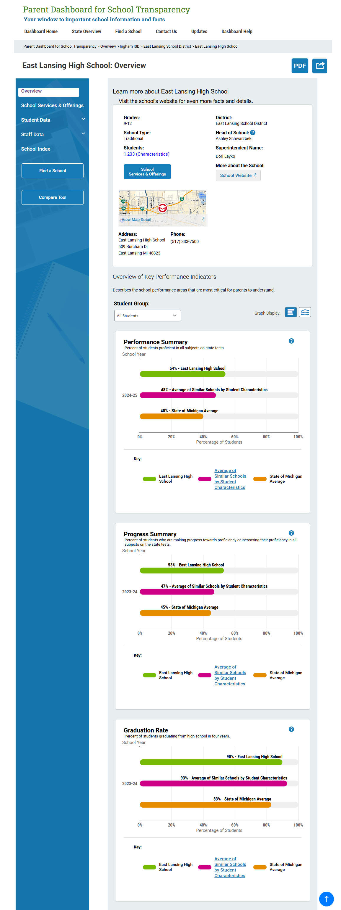

Slide 23
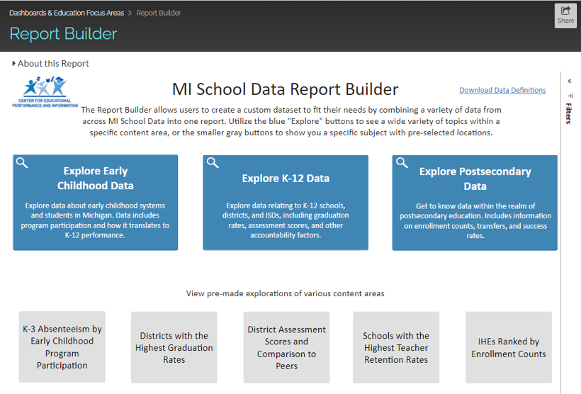

Slide 24
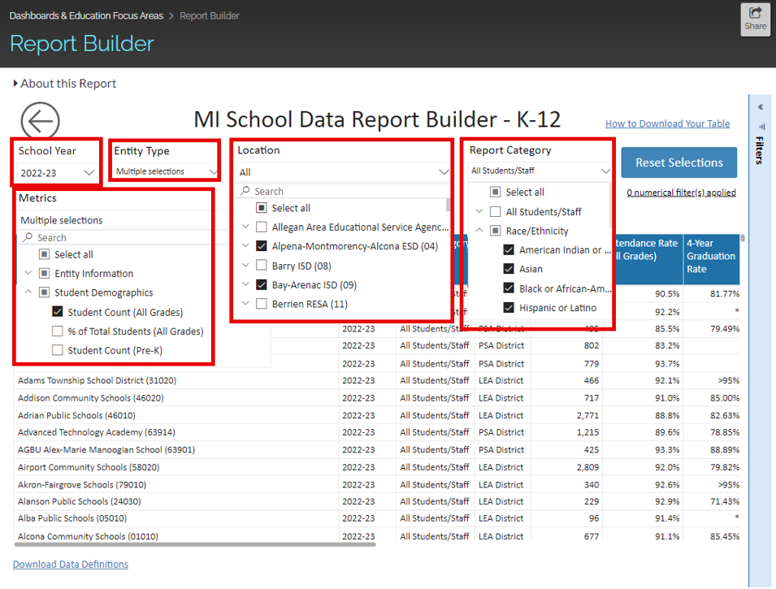

Slide 25
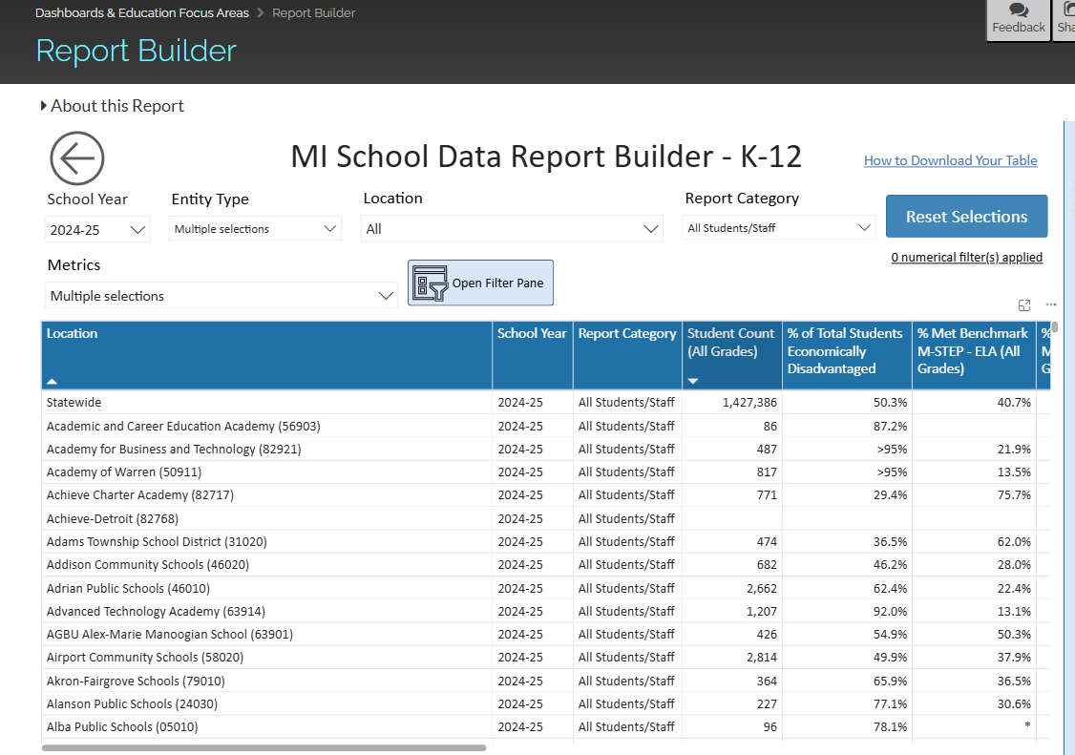

Slide 26
STATE SLIDES: Minnesota

Slide 27

SLEDS.MN.US

Slide 28
Statewide Longitudinal Education Data System (SLEDS)
PK-12
Post-Secondary
Workforce
Gauge effectiveness of current programs and design targeted improvement strategies to help students
Notes:
Brings together data from PK-12, post-secondary, and workforce to help gauge effectiveness of current programs and design targeted improvement strategies to help students

Slide 29
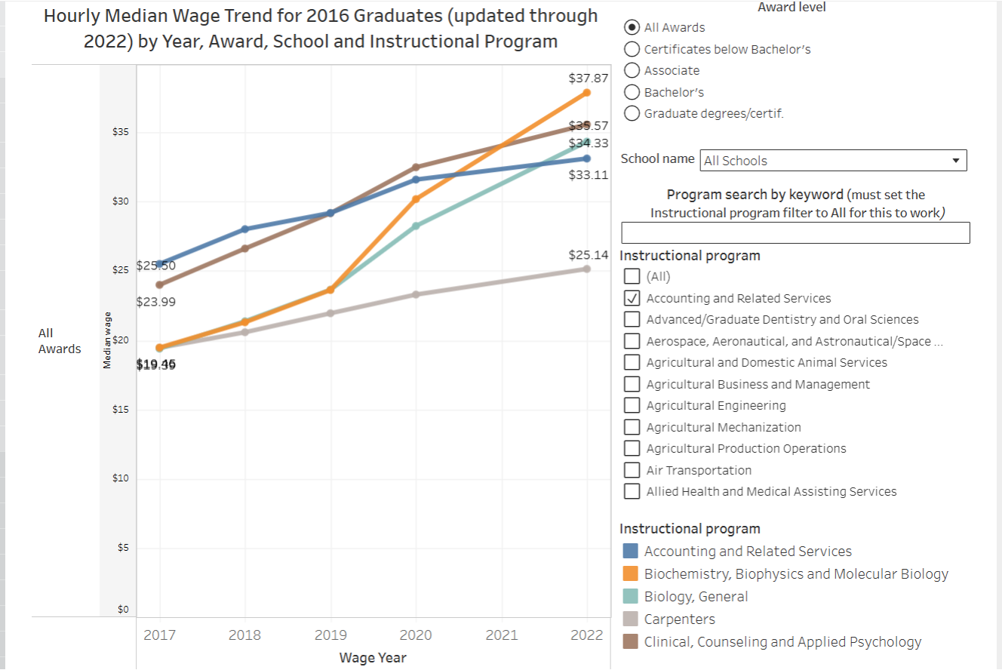

Slide 30
Questions to Answer
Where do your students go to college? What is the most common 2-year program? 4-year?
What is the average ACT score of students in our district? How does it compare to the state average?
What % of students take developmental courses when they enter college?
What degree/certificate is most common for your students?
What percentage of your students go to college the fall after graduation?
What is the average hourly wage for first-year employees in nursing?

Slide 31
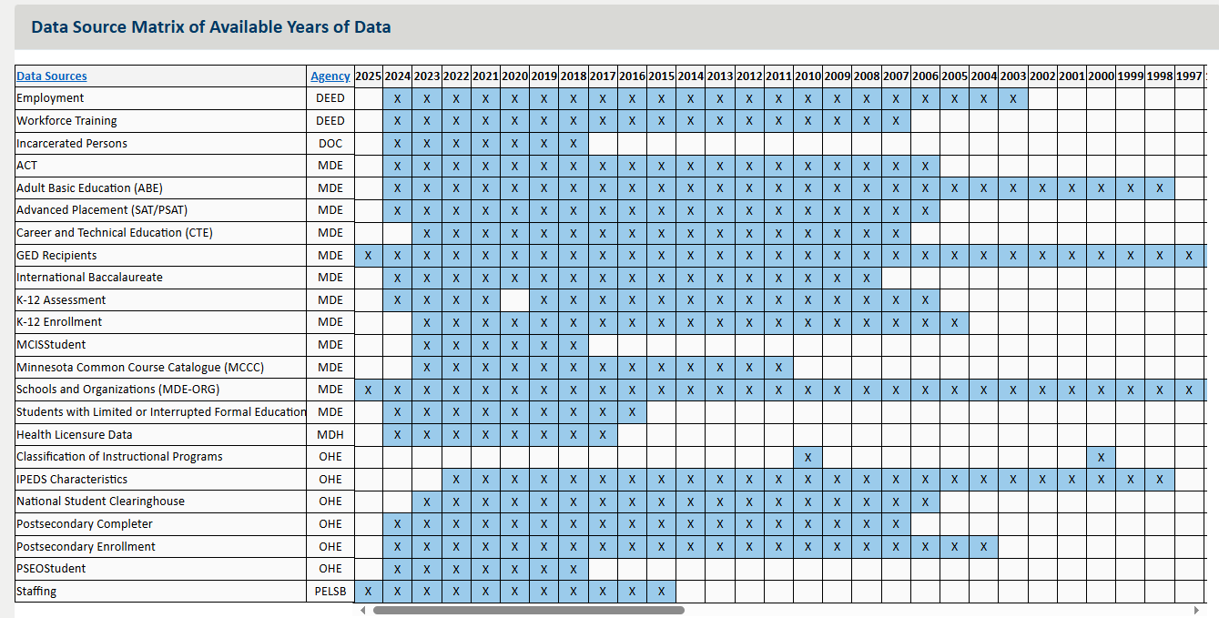
SLEDS Data Matrix
A list of data sources, their originating agency, as well as years available can be found on the Research tab

Slide 32
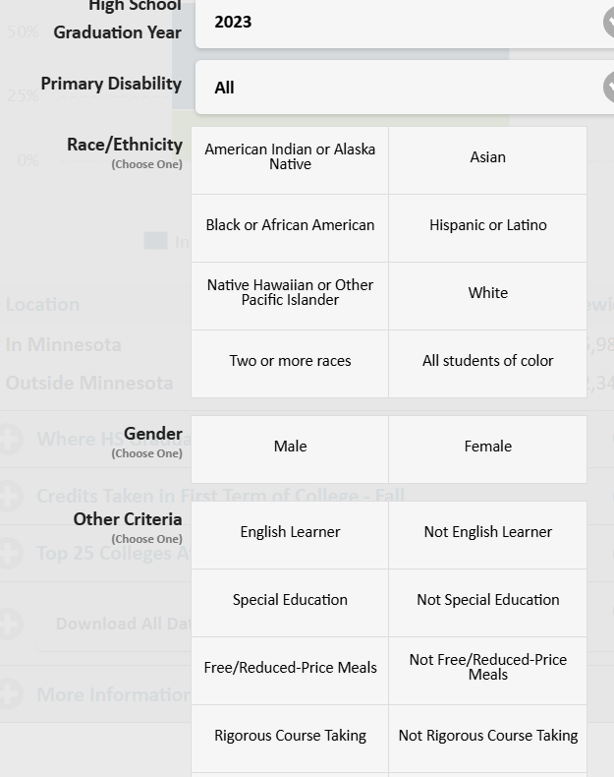

Slide 33
STATE SLIDES: Nebraska

Slide 34

Eight Outcomes
Notes:
NSWERS supports decision making for eight longitudinal outcomes within Nebraska’s education and workforce training systems. We currently have four education outcomes and four workforce outcomes. NSWERS has found that these first eight outcomes are fundamental for stakeholders who make decisions about learning and earning pathways in the state.

Slide 35
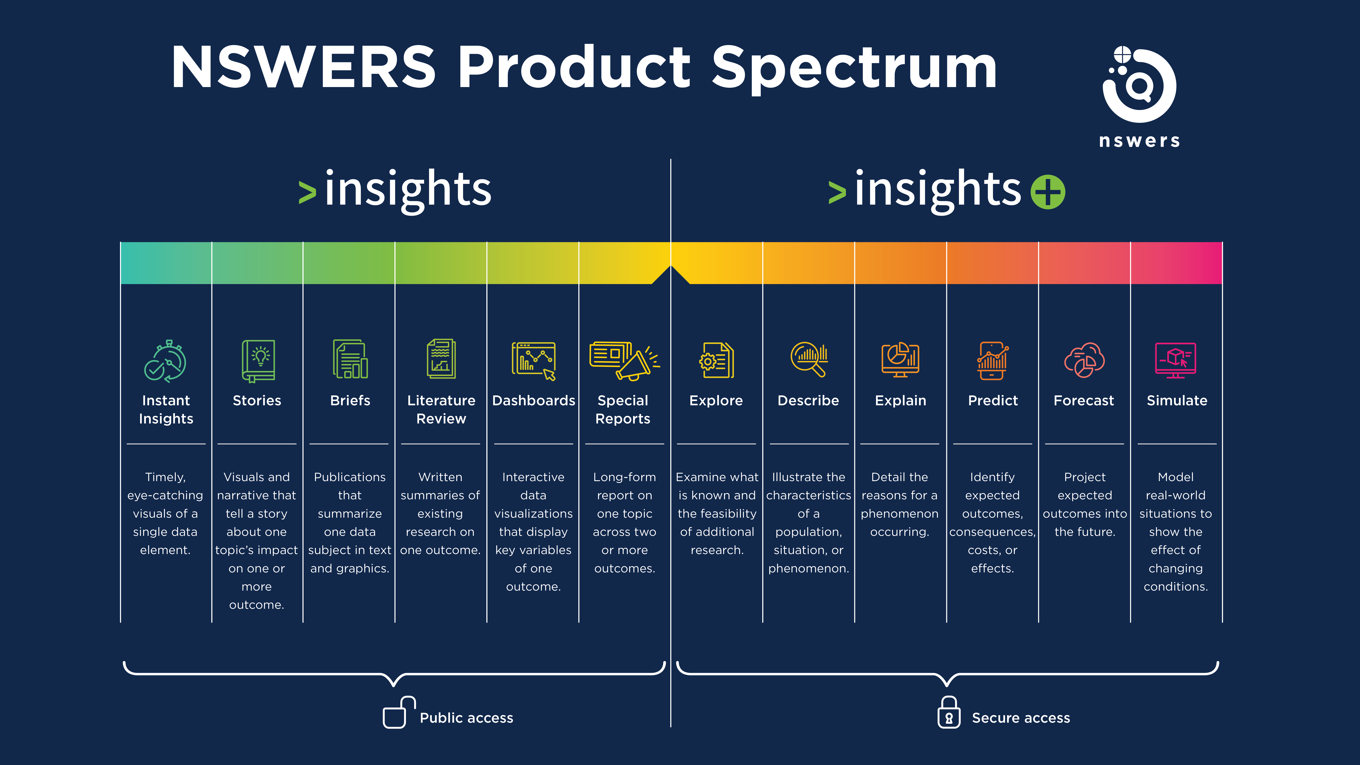
Notes:
NSWERS classifies data products across a continuum called the NSWERS Product Spectrum. The spectrum is two-sided. The left houses the insights products, meant for public viewing. A variety of products are offered here to the public, moving from a quick overview of a topic on the far left to more data-rich, targeted, and tailored products. The right side of the NSWERS Product Spectrum houses the secure insights+ products built for NSWERS’ partners and found on the insights+ web platform.

Slide 36

insights
Web-based public information tool
Available at insights.nswers.org
Supports all Nebraskans in their learning and earning decisions

Slide 37
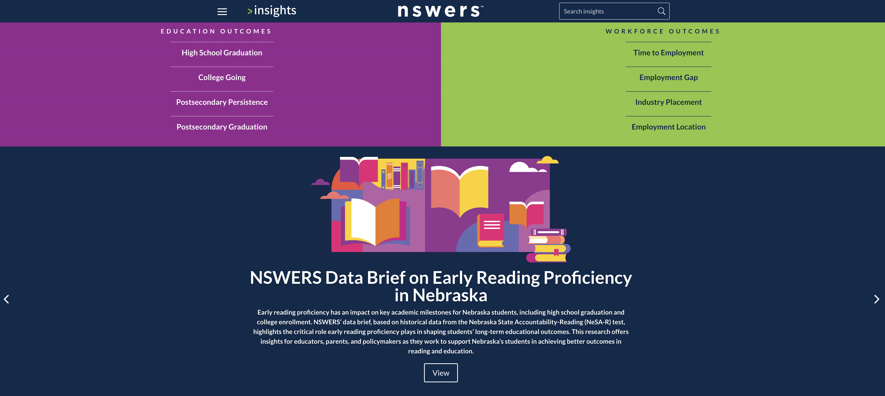

Slide 38
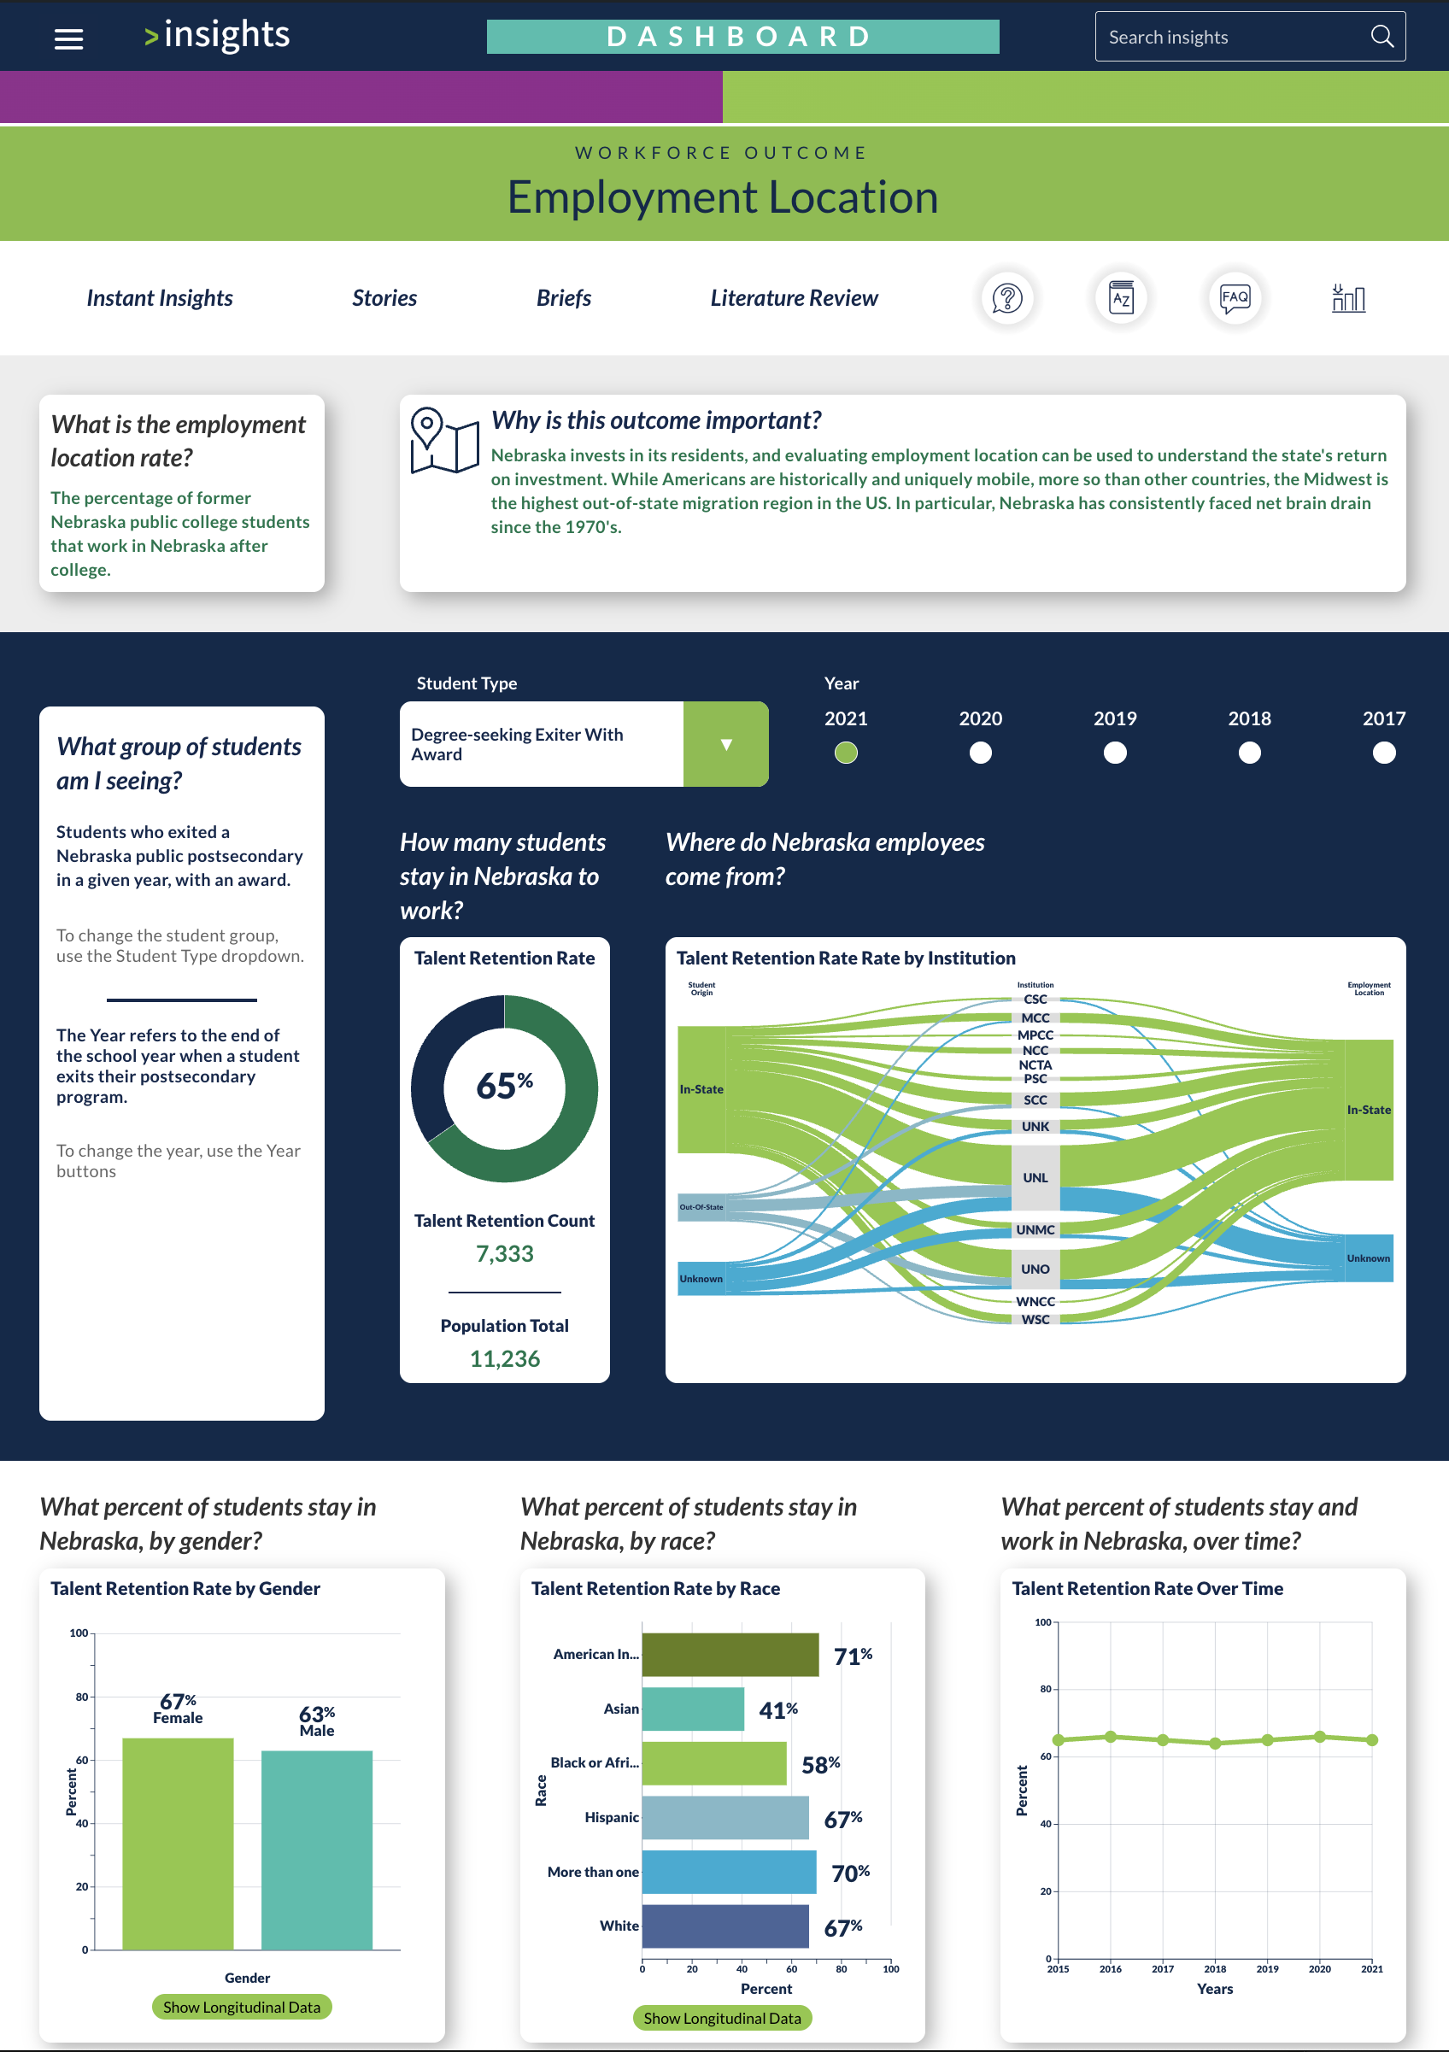

Slide 40
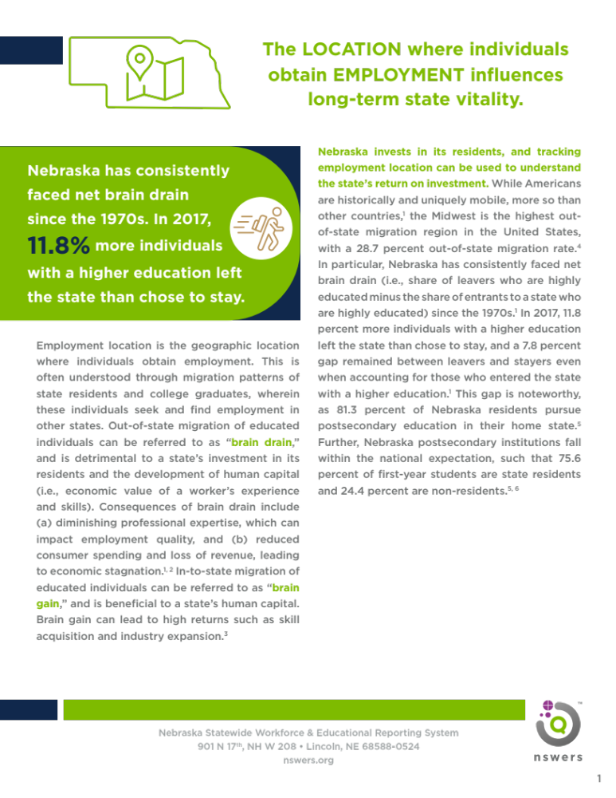

Slide 41
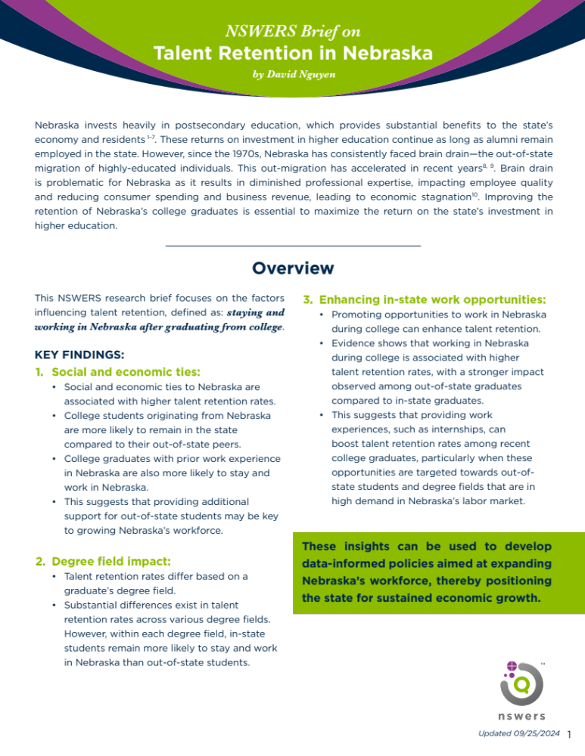
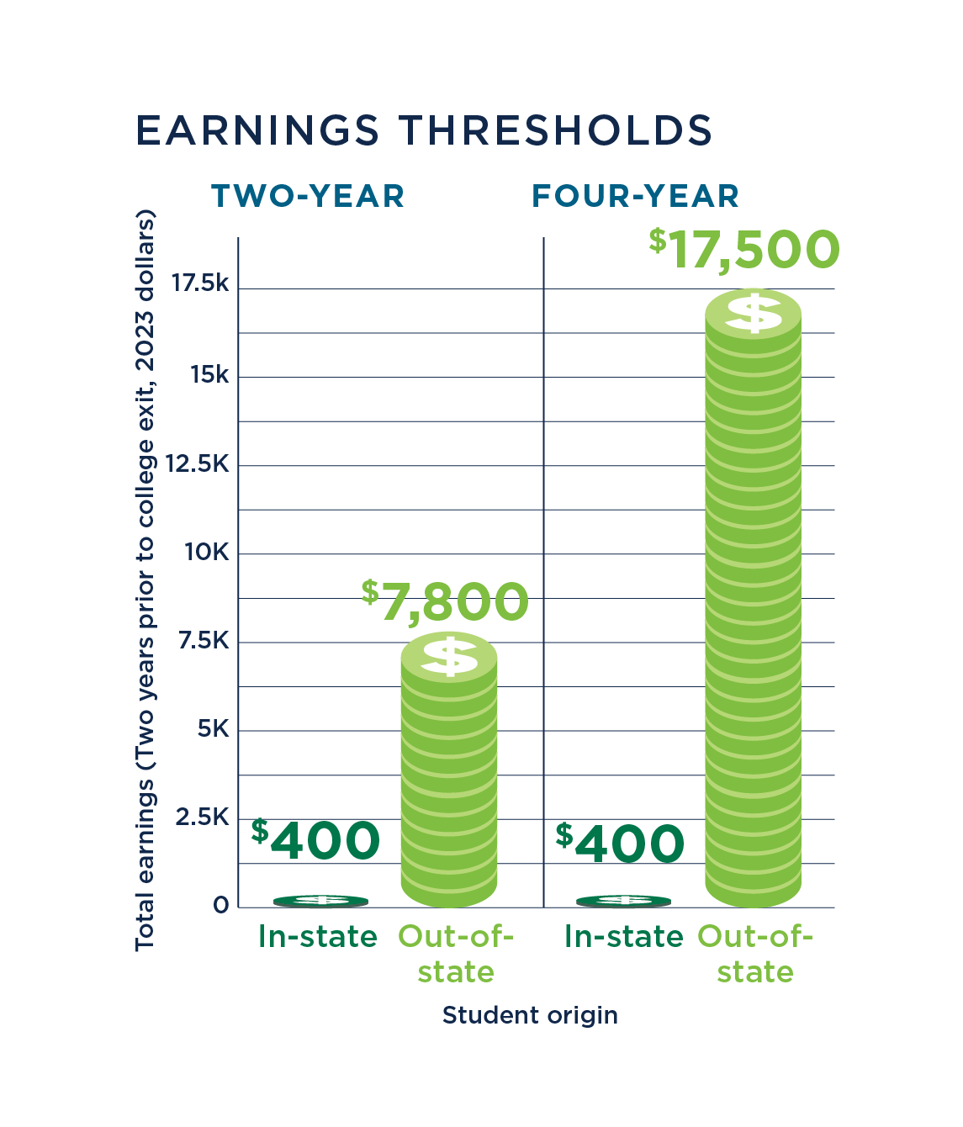

Slide 42
insights+
State-of-the-art secure web platform where NSWERS’ partners conduct business with NSWERS staff
Access to cutting-edge data and research products across eight outcomes and six stages
Supports decision makers in the education and workforce sectors

